Slide 1
Phase 4

Slide 2

MaN’s
ArCaDe

Slide 3

arcade merchandize (Jacket only)
Introduction of Arcade ads trafficking
Introduction of arcade calendar and competitions
Introduction of Arcade Garage
Introduction of Studio room merchandize
Introduction of Arcade essentials
Introduction of Arcade support Aid
Introduction of Arcade’s Friends
Introduction of Arcade Scent pro

Slide 4
Building Expansion
There would have to be some necessary expansions to the Dome arcade building in order to include some more services and features

Slide 5
arcade merchandize
(Jacket only)

Slide 6

Dome arcade Merchandize Jacket
only 50,000 made annually
New color way Releases on October 28
Contains: 2 plastic belts, waterproof interior, zip able pouch, zipable base, Glow in the dark “arcade”
Can't be bought on point (30 days)
30 Studio bucks or (N75,000) only
To buy after sold out 40SB or (₦100,000)
with hoodie 48SB (N120,000) only
10% off for Kids (10 years max)

Slide 7
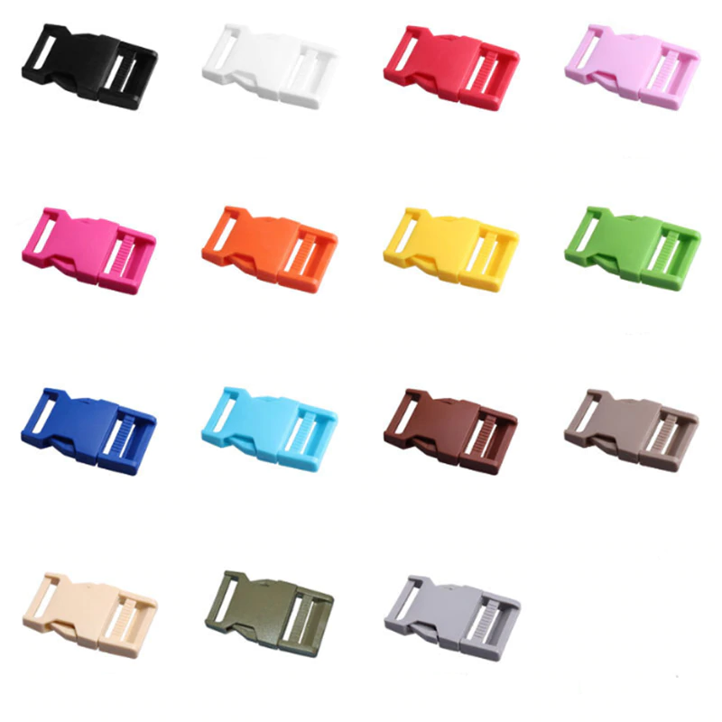
belt buckle
N2500
Per piece

Slide 8
Introduction of Arcade ads trafficking

Slide 9
Arcade ads trafficking
Get advertisement support with us at mans arcade
All Systems Wallpapers daily- N100,000 + 40SB (NRF)
10 seconds ads 100 times - N100,000 + 40SB (NRF) daily
Compulsory download apps - N500,000 + 400SB (NRF) per event

Slide 10
Our future partnerships offer
Companies advertisements per week would be the systems wallpapers or 10 seconds ad (₦500,000 - ₦1,000,000) and food from the food companies would be allowed into the studio rooms exclusively (
Make referrals play unleaked and unreleased music at the arcade subscription (N 249 monthly )

Slide 11
Dome arcade calendar (N1499)
List of all monthly activities that you can participate in

Slide 12
Criteria finding game
Find someone in a given criteria eg (dog named jack) then that person must find someone in another criteria etc until the thousandth person completes their criteria all the 1000 people would earn prize (30 days)
People found with the criteria must then register

Slide 13
Arcade activities
Requirements to participate
Pay registration fee 1SB per event, force book slot (4SB)
Download sponsored apps
Bring at least 3 guests (they must register to watch)
Reshare competition on all platforms
Follow our social media on all platforms
All registers get a slot In a queue for next timing
To be a watcher or guest pay (10MST)

Slide 14
Hands on the wall happens on the first day of each month
Merch streaks and daily streaks happen everyday
Once customers lose they would be given tips and a drink
After a customer loses 50 times they earn 1VM
Most activities Happen 15 days a month
Sports related is 2SB per player and 20MST per watcher

Slide 16
Name day …1000 ppl
Record while counting …2000 ppl
Stay blind folded …1000 ppl
Starring contest tournament …10,000 ppl
Treasure haunt …10,000 ppl
Rock paper scissors tournament …10,000 ppl
Tic tac toe tournament …10,000 ppl
Chess tournament …10,000 ppl
Monopoly tournament …5000 ppl (2 times daily)
Scrabble tournament …10,000 ppl

Slide 17
12 Hands on the wall …500 ppl each 15m + 9m
Criteria finding game …10,000 ppl 25m +15m
Raffle month …10,000 ppl 25m + 15m
Dope ad challenge …10,000 ppl 25m + 15m
Soccer 20 minutes match 24 ppl (40 matches) 4.8m + 2.8m
Basketball 20 minutes match 10 ppl
Plastic bottle collection challenge 100,000 max
Guess the number 30,000
Typing competition 100 people (10 times a day)

Slide 18
Money made + 30M(hands on wall)
500 15 + 0.75
1000 7.5 + 1.5
2000 10 + 3
5000 12.5 + 7.5
10000 175 + 15

Slide 19
January
Variable musthyds count , (recorded while Counting (on cardboard))
February
Merch shirt, (Name day)
March
(Most streams (hours)), Starring contest tournament
April
Studio room shirt, (Rock, paper, scissors tournament)
May
(Most games (Hours)), (Criteria finding game)
June
Merch jacket release, (Mannequin challenge day)

Slide 20
July
(Most studio bucks purchased), (Monopoly tournament)
August
(Tic tac toe tournament), (Treasure haunt day)
September
(Most services used), (Chess tournament)
October
daily streaks, (Stay blindfolded)
November
(Raffle month)
December
Dope ad challenge, (Scrabble tournament)

Slide 21
Arcade Garage

Slide 22
Arcade Garage
Arcade Garage works with Arcade pay to enable customers purchase items with installments and subscribe to items at low-cost payments ranging from weekly to per 6 years. customers can also pay per second
Rent from arcade
Pay to get huger subscriptions for physical products
Arcade Garage allows customers to subscribe to as many products as possible and would be charged per second of ownership

Slide 23
E.G. Buy a Car (add 1.5M car)
Buy a Car – (Pay 9SB weekly for 5 years)
Company takes 10% the price as registration fee
upgrades every 5 years N6m car
Buy a Car – (Pay 23SB weekly for 5 years)
Company takes 10% the price as registration fee
upgrades every 5 years N15m car
Buy a Car – (Pay 46SB weekly for 5 years)
Company takes 10% the price as registration fee
upgrades every 5 years N30m car
Buy a Car – (Pay 135SB weekly for 5 years)
Company takes 10% the price as registration fee
upgrades every 5 years N70m car
Price also consists of minor damage insurance and fuel bills
There would be Suggestions to replace the car with a similarly priced one after 5 years

Slide 24
Customers would scan refuel stations given QR code to confirm payment to claim their free fuel
customers would also get a free access to 2 arcade cabs daily, incase of complications involving the cars
Customers also get access to a free maintenance check once every 6 months
Free fixing of scratches and minor damages are also alowed

Slide 25
Buy a Swimming pool
Buy a Swimming pool-(Pay 6SB for monthly ownership ) intex pools
2 years plan (15k monthly (2 years plan)) sell games at discounts
buy big generator (25k weekly)
ac (4k weekly)

Slide 26
Television
Pay 10SB monthly renews every 2 years
Pay 6SB monthly renews every 3 years
Pay 4SB monthly renews every 4 years
Pay 3SB 30MST monthly renews every 5 years

Slide 27
Rent a Console
Rent a console (N9,000 for a monthly ownership only) for portables
Rent a Console (N12,000 for a monthly ownership only) for older gen
Rent a Console (N15,000 for a monthly ownership only) for newer gen
Rent a Game (N1,500 for a weekly ownership only) for newer games
Rent a Game (N1,000 for a weekly ownership only) for older games

Slide 28
Rent music instruments and sound EQT

Slide 29
money must be payed to arcade pay account 2 weeks before needed (monthly) 3 days before needed (weekly) 1 month before needed (3 to 12 months)
arcade garage services are offered for all products except portables

Slide 30
Introduction of
Studio room merch

Slide 31
Merch Studio room (N4999 only)(2 Studio bucks)
New color Releases on April 28 annually
Unlimited amount
Contains: Glow in the dark “UD”
Comes in 4 different styles
New color way each year

Slide 32
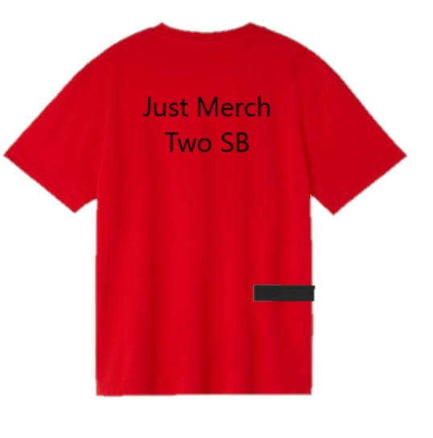
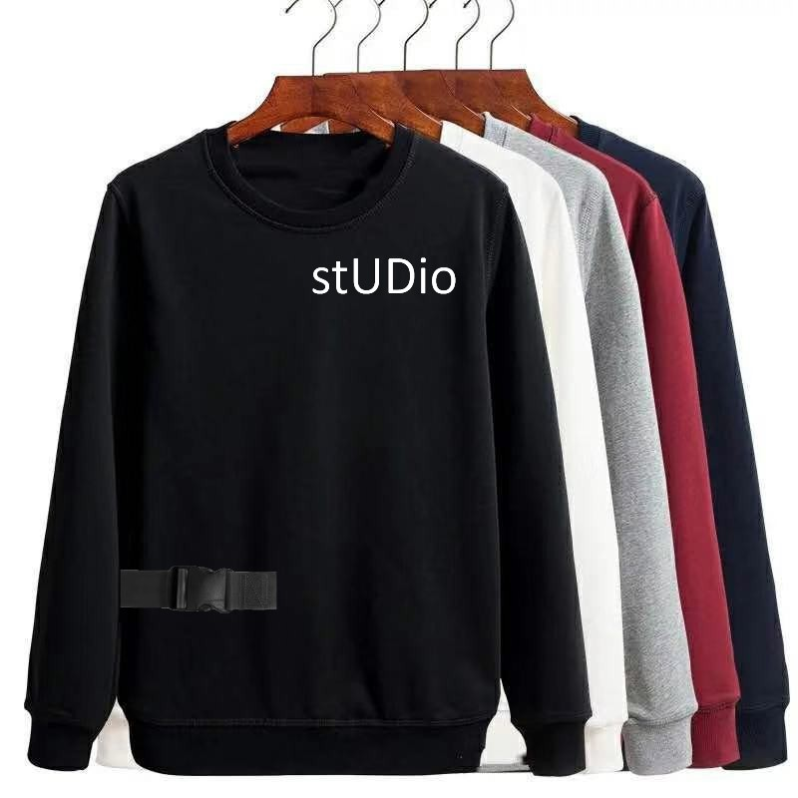

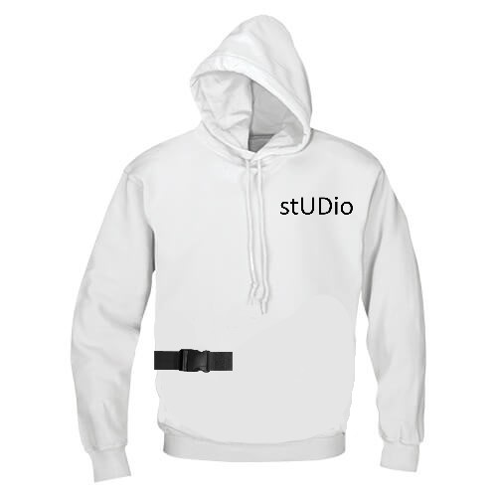
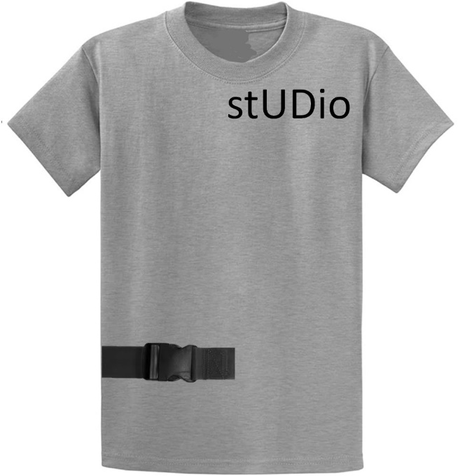
Studio merchandise
Unlimited supply
New color way Releases on October 28
Releases with all previous colors
Contains: 1 plastic belts, Glow in the dark “UD”
Shirt only 2SB or (₦4,999)
With sleeves 4SB or (₦9,990)
With Sleeve and hoodie 8SB or (₦19,990)
10% off for Kids (10 years and below)

Slide 33
Buy annually to earn
Get free Drink for 3 months
10% off all food for 1 month
Variable points to be kept
Stand a chance
Participate in merch streaks

Slide 34
belt buckle
₦2,500
Per piece

Slide 35
Introduction of Arcade essentials

Slide 36
Times Per Duration (TPD)
This allows members to enjoy the services or essentials benefits multiple times across different intervals
Users get different colors of caps per subscription
There are 3 different TPD samples
Times per week (TPW)
e.g. 4 times a week for 3 weeks = 4TPW3
Days per number of weeks (DPW)
E.g. 2 days a week for 6 weeks = 2DPW6
weeks per number of months (WPM)
E.g. 5 weeks in 12 months = 5WPM12

Slide 37
Budget Essentials N5k 1TPW2 (2 days) (1 person)
Allow gadgets (one only)
3 hours of streaming in Studio room
2 popped corns, bottles of water, drinks + FOD
45 minutes gaming
Arcade online
Light blue Arcade cap

Slide 38
Duo Essentials 10k 1TPW4 (4 days) + gifting up to 2 people enjoy at once
Arcade Cab
Allow gadgets
8 hours of streaming in Studio room
2 hours of Arcade sub in Studio room
4 meals, popped corn, bottles of water, drinks + FOD
2 hours gaming
Arcade online
Red Arcade cap

Slide 39
extended Essentials 20k 4TPW4 (16 days) + gifting up to 3 people enjoy at once
Arcade Cab
Allow gadgets
16 hours of streaming in Studio room
16 hours of Arcade sub in Studio room
16 meals, popped corn, bottles of water, drinks + FOD
16 hours gaming
Arcade online
Orange Arcade cap

Slide 40
game boy premium 30k 6TPW4 (30 days) + gifting up to 3 people enjoy at once
Arcade Cab
Allow gadgets
15 hours of Arcade sub in Studio room
20 bottles of water, drinks
120 hours gaming
Arcade online
Dark green Arcade cap

Slide 41
Pro Essentials 45k 6TPW5 (30 days) + gifting up to 4 people enjoy at once
Arcade Cab PRO
Allow gadgets
45 hours of streaming in Studio room
45 hours of Arcade sub in Studio room
30 meals, popped corn, bottles of water, drinks + FOD
15 hours gaming
Arcade online
Purple Arcade cap

Slide 42
premium Essentials 60k 6TPW5 (30 days) + gifting up to 6 people enjoy at once
Arcade Cab PRO
Allow gadgets
60 hours of streaming in Studio room
60 hours of Arcade sub in Studio room
30 meals, popped corn, bottles of water, drinks + FOD
30 hours gaming
Arcade online
White cap

Slide 43
No budget Essentials (N40k per hour) up to 10 people enjoy at once
Full access to everything
Black cap

Slide 44
lost customer
The User decides what to pay or subscribe for and can arrive on any day. Opposite of No Budget Essentials

Slide 45
Introduction of Arcade support Aid

Slide 46
Arcade support aid
Pay 30% of the price of all purchases related to Man’s arcade for 10 years then pay us the sum you saved monthly at a 5% interest (per month of payment not completed).
Bills are to be completed within 500 days after use. Users must meet requirements to participate.
Arcade support aid would be pushed to any money conservative user on registration of arcade pay.

Slide 47
Introduction of Arcade’s Friends

Slide 48
Arcades friends is going to be established to appreciate the Good that Man’s arcade is going to be doing for people in order to tap into the emotional part of our customers and to add value to the company as a whole.
Arcade friends should take the first 30 minutes of the annual dome arcade conference to let customers know that our new announcement is just another generation of features and services to better the lives of others

Slide 49
Examples of passionate advertisements are
actors and actresses saying that it’s not about the services they enjoy from Dome arcade, it’s about the feelings gotten when your there and the amount of money you would save over time. online influencers saying that the arcade online bundles changes the way they work and helps them forget about data when exporting large videos the entire experience is magical on how they pay less for more
other influencers saying while using arcade pay extra and arcade garage they don’t need to worry about any form of expenses yet stay up to date with the latest stuff and that no other company can make me feel safe like that
homeless man saying that the referrals program has helped him make ends meet and now he has a job that pays him well
school kid says she has dreams for Nigeria and that the referrals program was the only way she was able to generate a large income to start investing in. and it’s only possible with dome arcade

Slide 50
woman says she bought a new expensive car for her husband because it was his dream car and she would have never been able to purchase it without dome arcade garage and now dome arcade pays for the fuel bills and minor damages bills and after 5 years done arcade promises to give the latest version at no additional cost
Man says he proposed with an expensive diamond ring and took his wife to Dubai because of dome arcade pay extra he got it 50% off and now he is happily married and had a good time in Dubai thanks to Dome arcade
Woman says her son had been disturbing her for more data more data, Ps5, FIFA 20, FIFA 21, FIFA 22 and all those expenses that she couldn’t pay for at the time but now her son uses arcade cab to visit the dome arcade to play all the games he wants with unlimited Wi-Fi then returns using the arcade cab. and dome arcade has really impacted on her
Teenager say imagine watching the latest blockbuster movies in a cinema while eating food like KFC, pizza hut and other snacks not allowed in boring cinemas without worrying about anyone else. yup stop imagining you get private rooms for streaming and gaming it’s all in dome arcade
Man says Dome arcade just came in and revolutionized everything, from the way we pay to how much we pay to lifestyles products and affordable presented entertainment, truly he doesn’t thin any company can do half of what arcade pay does and its like the apple in tech or the Nike in sports clothing

Slide 51
Woman says being fired from work saved her life because on her way home she met a referral and used our services for months then was told she earned 5 variable musthyds in 3 months of unemployment from watching movies and playing games. then she sold the 5 for N800k which is way more than she earns in 3 months
Man says he needed only 5 variable musthyds to win Prices and he bought them for only N800K but got back over N5,000,000 from that purchase and that was the purchase that changed his life
Blind man says he was able to run his farm and sell his products without staying on the roadside and earn more than ever before

Slide 52
Arcade scent Pro

Slide 53
Luxurious perfumes
Users with up to 1kSB are entitled to an exclusive access to 2 sprays of an exclusive designer perfume brand

